Slide 1
Delinquency TELECOM MODEL

Slide 2
What is Delinquency telecom model ?
Delinquency is a condition that arises when an activity or situation does not occur at its scheduled (or expected) date i.e., it occurs later than expected.
In this project we have data of 190001 users of a telecom company, the data includes information such as.
1. for how may years user is using the network.
2. how many times he takes loan in 3 months.
3. average amount he pays back in 3 months.
4. and will he be able to pay the loan in time or not.
This is a classification problem.

Slide 3
Libraries used in this project are
  Pandas.
  Sci-kit Learn.
Data split techniques used is K-FOLD with 10 folds
  Accuracy model used is confusion metrics.

Slide 4
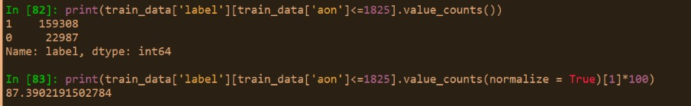
FEATURE SELECTION AND EXTRACTION
Age on cellular network
  Customers registered in network for less than 5 years.
  Customer registered in network for more then 5 years.

Slide 5
Daily amount spent from main account, averaged over last 90 days
  less than 0.
  less than 3645.
  Greater than 3645.

Slide 6
Number of days till last recharge of main account
  Equal to 0.
  Less than 7 days.
  Greater than 7 days.

Slide 7
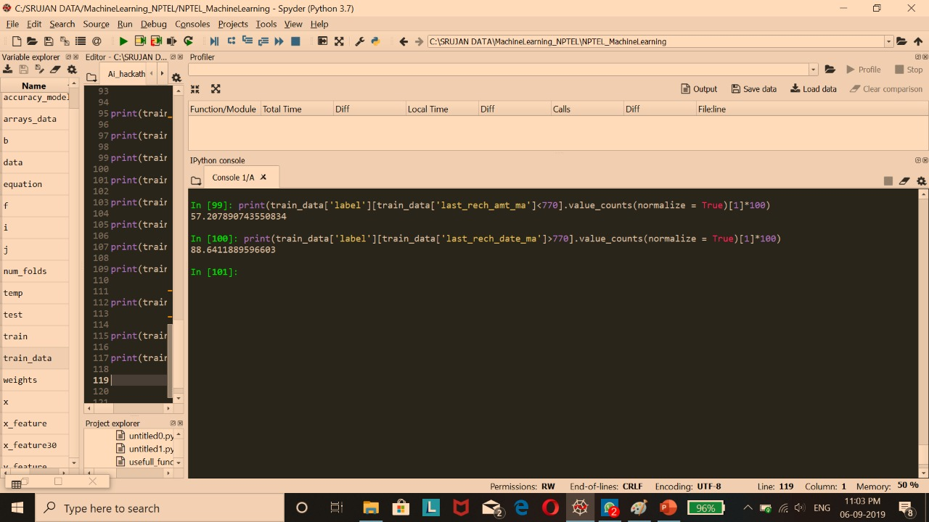
Amount of recharge
  Less than 770.
  Greater than 770.

Slide 8
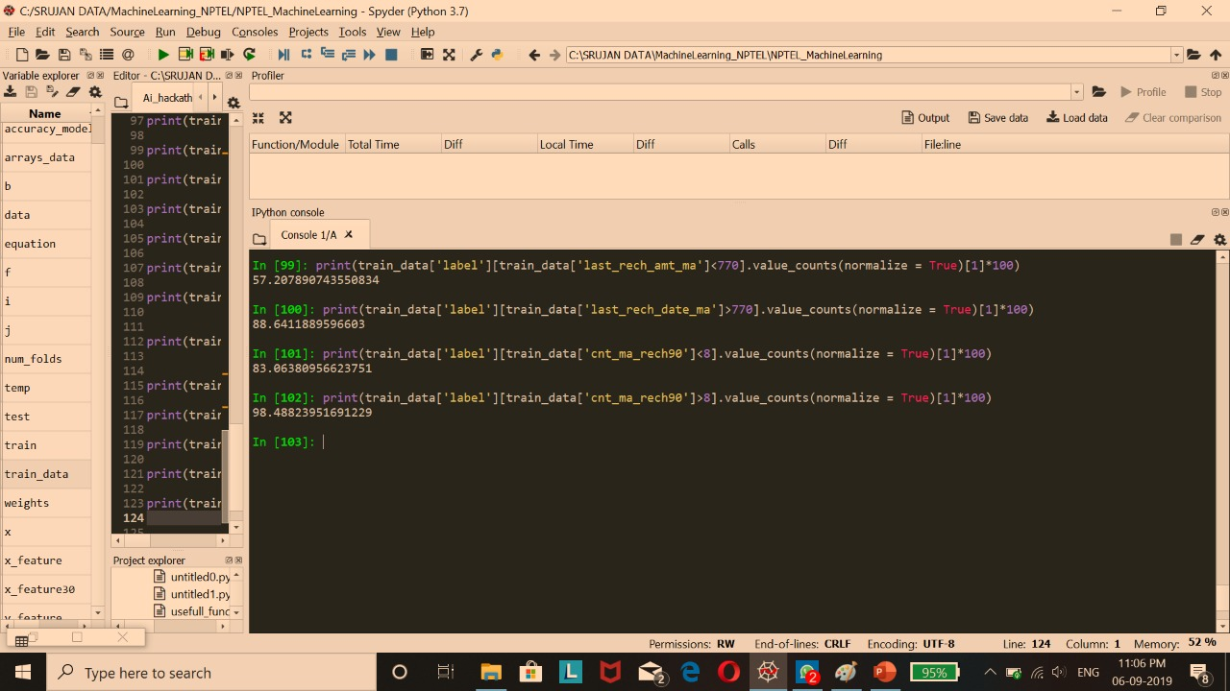
Number of times main account recharge, in 90 days
  Less than 8.
  Greater than 8.

Slide 9

Number of loans taken by user in last 90 days
  Less than 223.
  Greater than 223.

Slide 10

Maximum amount of loan taken by user in last 90 days
  Equal to 6.
  Greater than 6.

Slide 11

Average payback time in days over last 90 days
  Less than 10.
  Greater than 10.

Slide 12
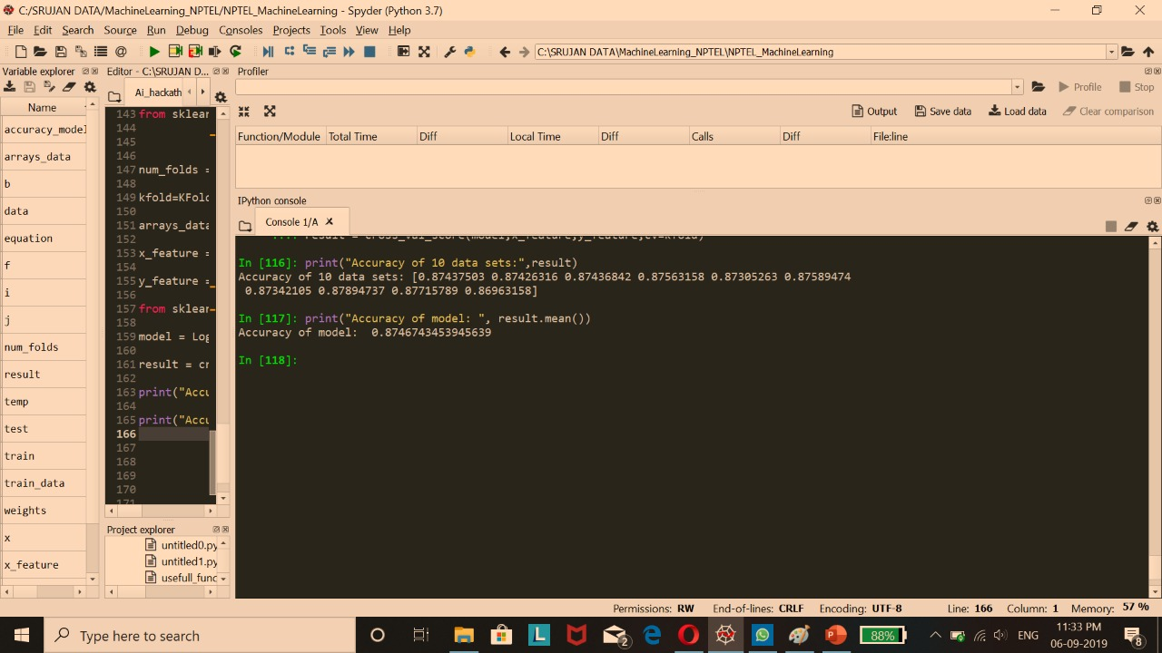
MODEL SELECTION AND ACCURACY EVALUATION
USING K FOLD
The data is split into 10 subsets and accuracy is evaluated.
  1. logistic regression.
  Accuracy 87 %.

Slide 13
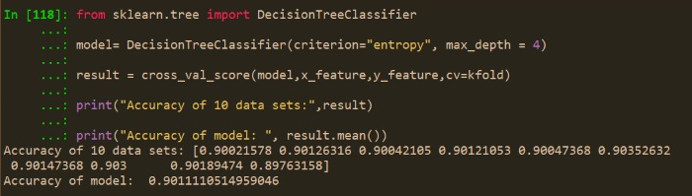
2. Decision trees.
Accuracy 90%

Slide 14
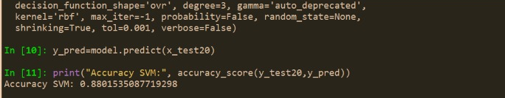
SVM Using 20% of Training Data
Model training time 338.46114 sec. in CPU.
Model training time in IBM power system is 1.67 sec.
Accuracy of model 88% for 20% of test data.

Slide 15
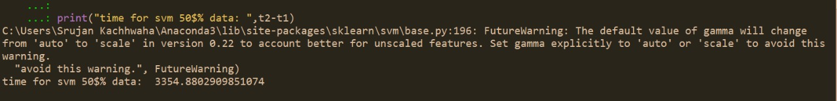
SVM 50% train data time in CPU
3354.8 sec.

Slide 16
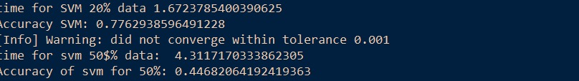
SVM 50% train data time in IBM power machine
4.311 sec.

Slide 17
THANK YOU
DIVINE AI
Srujan Kachhwaha
Vaibhav Mishra
Rohan Baghel
Aman Gupta

